Slide 1
Bike riders
Presented by: Tiago sousa
Last updated: January 27th, 2023

Slide 2

Table of contents
How to convert casual riders to Cyclistic annual memberships?
Result of the analysis
Conclusion

Slide 3
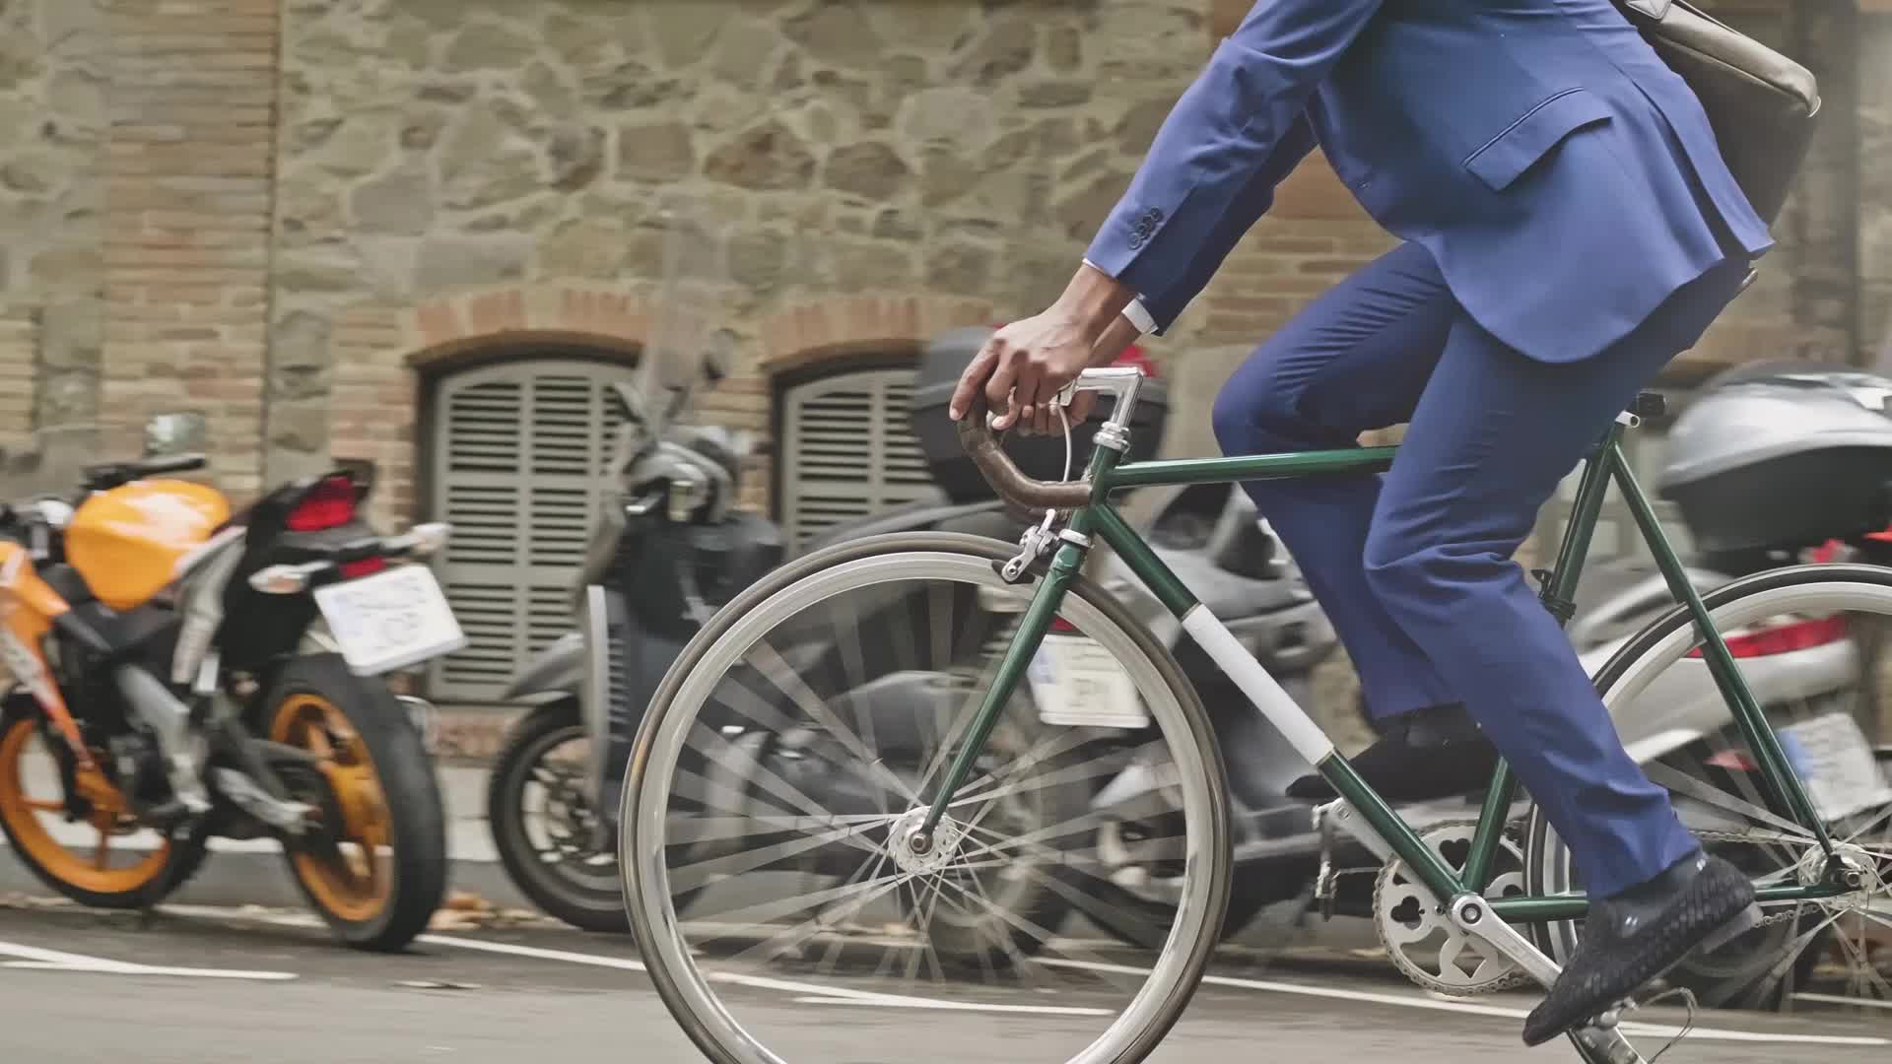
Objective
How do annual members and casual riders use Cyclistic bikes differently?

Slide 4
Number of riders varies widely by day of the week
Casual members are higher at weekends
Annual members are more active on workweek

Slide 5
Casual members have longer average rides
Annual member’s value faster rides

Slide 6
Conclusion

Slide 7
Conclusion
Casual members
Longer rides
Most at Weekends
Annual members
Faster rides
Most at Workweek
Recommendation
Make better conditions for riding a bike to work (more stations, more availability
Better rates at workweek

Slide 8

Thank you for your attention

